Slide 1



INDIRA GANDHI NATIONAL OPEN UNIVERSITY ( IGNOU )
Topic :- Noun
Subject :- English
Class :- 5th
Name :- Abhishek Kumar Ojha
Section :- 2019-2022

Slide 2
Agenda
Introduction
Definition of Noun
Types of Noun
Example & Definition of Noun
Practice Exercise
Noun

Slide 3
INTRODUCTION
Right from the moment the universe came into existence, grammar was here. Each entity of this world is separate

Slide 4
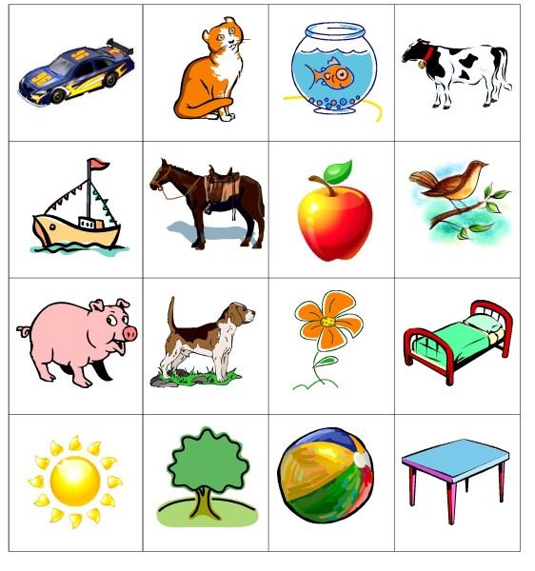
What is a Noun?
A noun is a word that describes a person, place, thing, or idea.

Slide 5
Types of Noun.
Common Noun
Abstract Noun
.
.
Proper Noun
Collective Noun
Concrete Noun
.
Noun
5

Slide 6
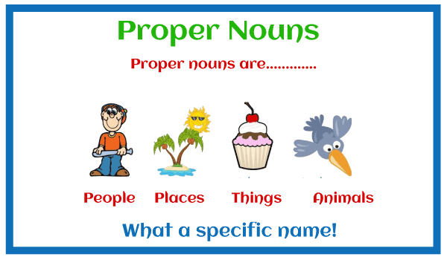
1. Proper Noun
Nouns that are used to name a person, place or thing specifically are called a proper noun. Proper nouns always begin with a capital letter.

Slide 7
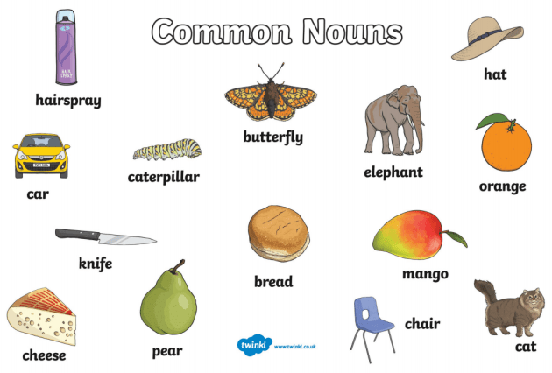
2. Common Noun.
Common nouns are those nouns that refer to a generic item, group or place. This means that, unlike proper nouns, they are not used to identify specific people, places or objects.

Slide 8

3. Collective Noun.
A collective noun is a naming word that is used to denote a group of objects, animals or people.

Slide 9
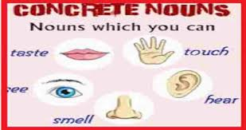
4. Concrete Noun.
A concrete noun refers to objects that are material and can be perceived by the human senses.

Slide 10
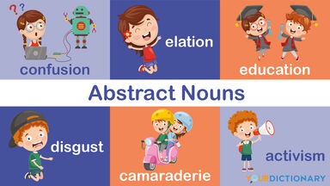
5. Abstract Noun.
Any entity that cannot be perceived by the five senses of the human body are called an abstract noun.

Slide 11
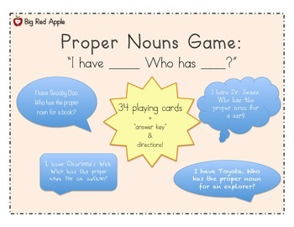
PRACTISE EXAMPLES
CC BY-NC

Slide 12
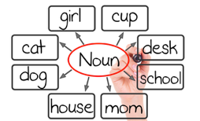
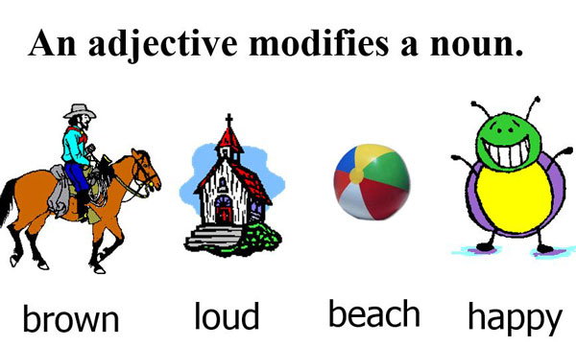

Slide 13
The End
Thanks to all teachers for giving me the opportunity to make the project.

